Slide 1


Web Development
Prepared by:
Nouran Ebrahim El Mohamady
تحت إشراف/ م. محمد خيري

Slide 2

PETS LOVERS
This project about pets (cats , dogs and birds) for care and shopping.
You can buy cats ,dogs and birds and their accessories and foods.
You can share your stories and experience with your pet .
You can ask doctors for any problem with your pet.

Slide 3
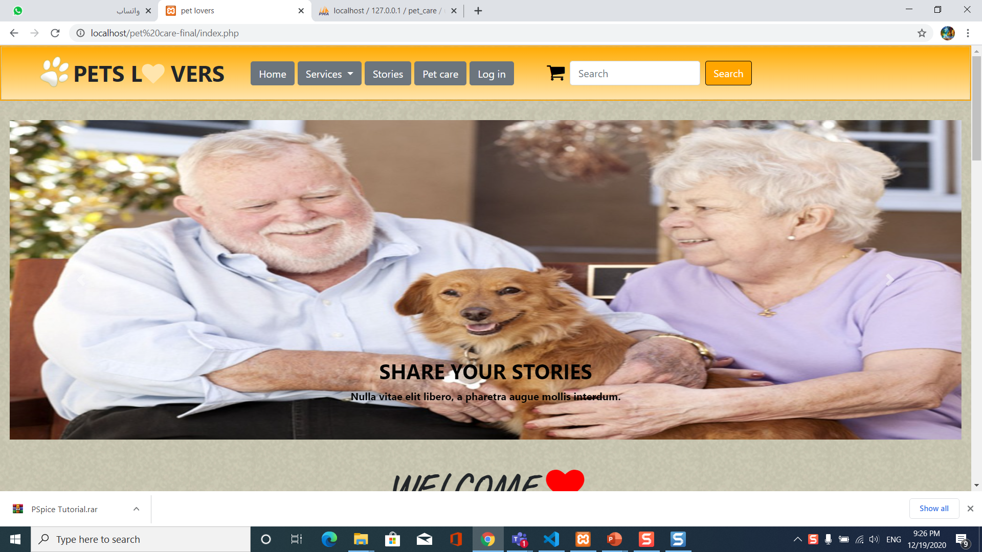
Home
Html
Css
Bootstrap
php

Slide 4
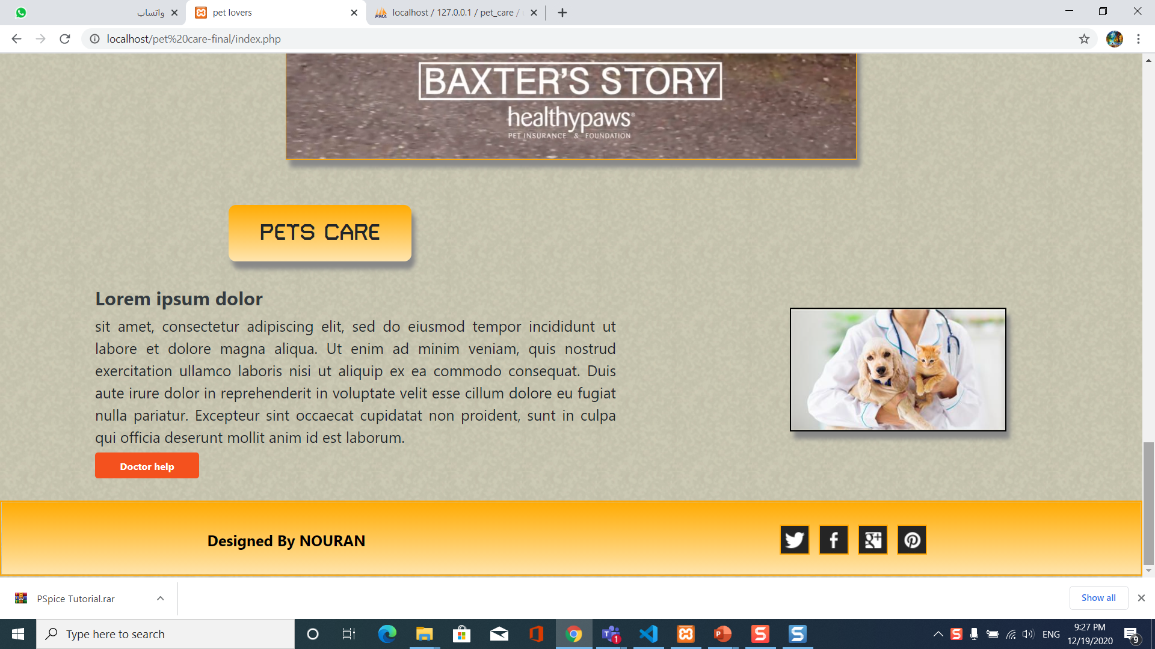
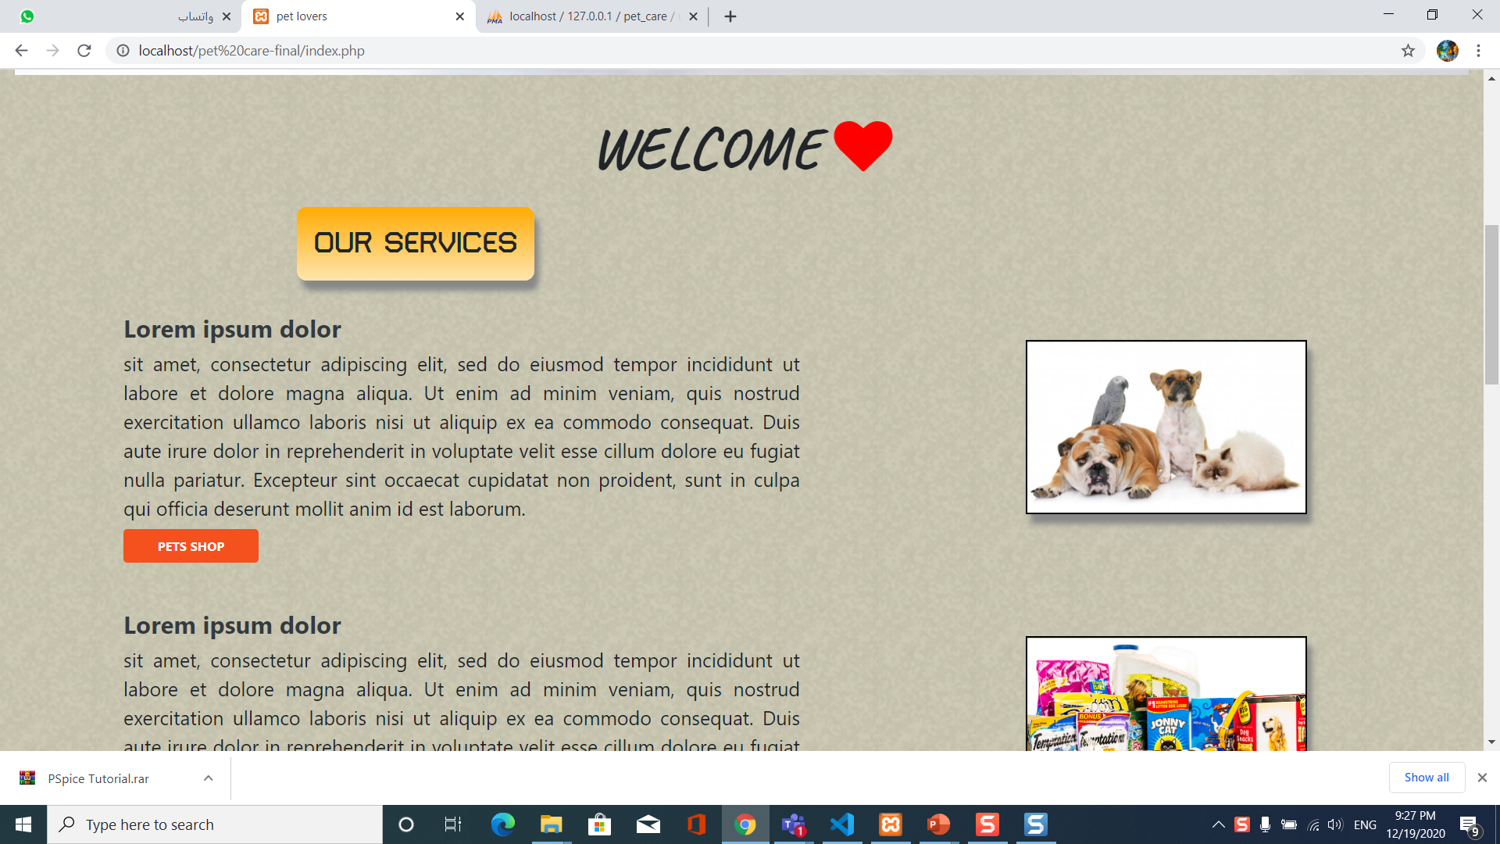

Slide 5
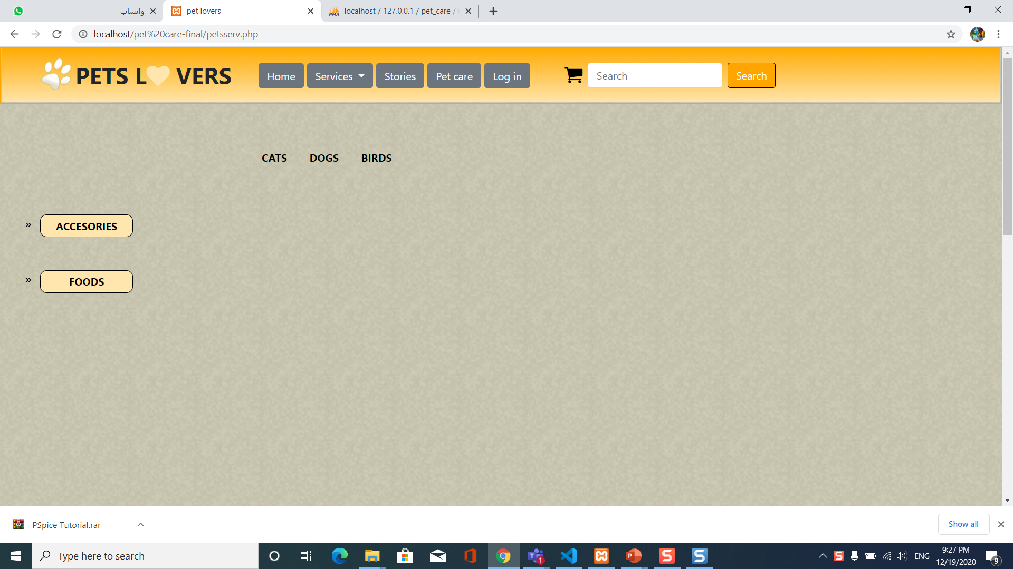
Services - pets
Html
Css
Js
jquery

Slide 6
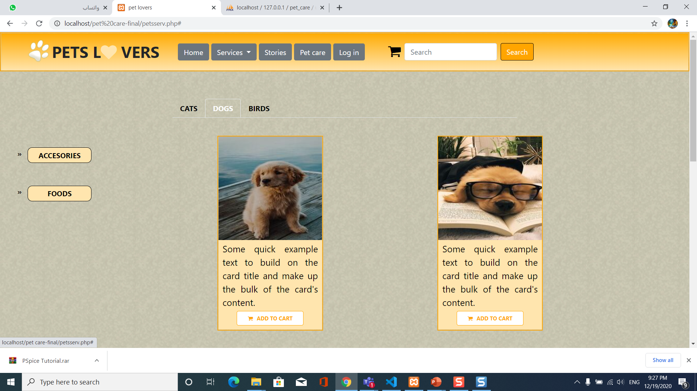
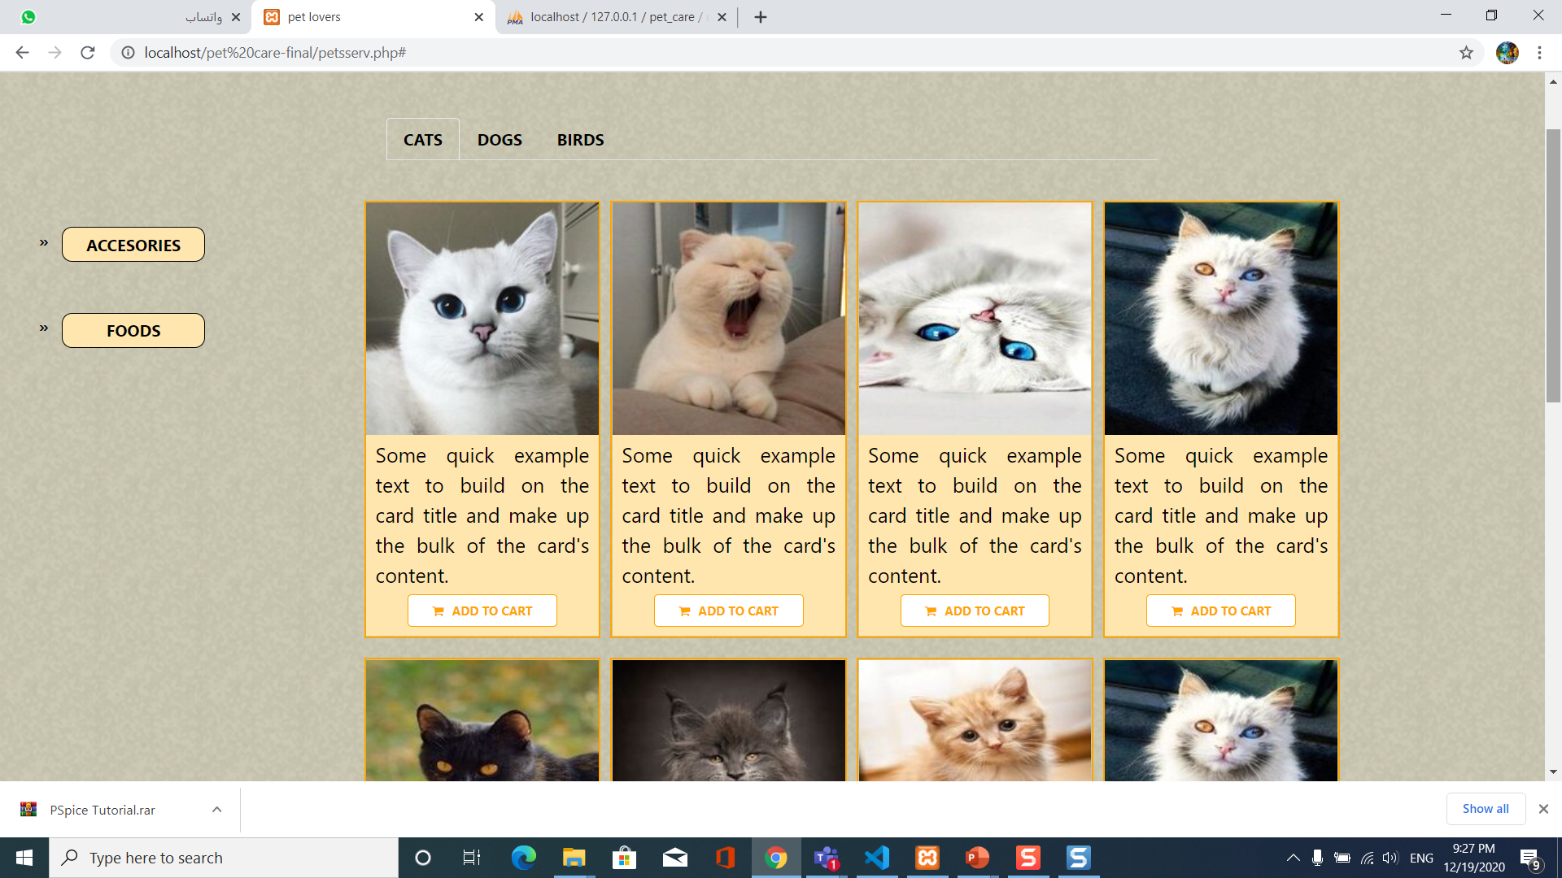

Slide 7
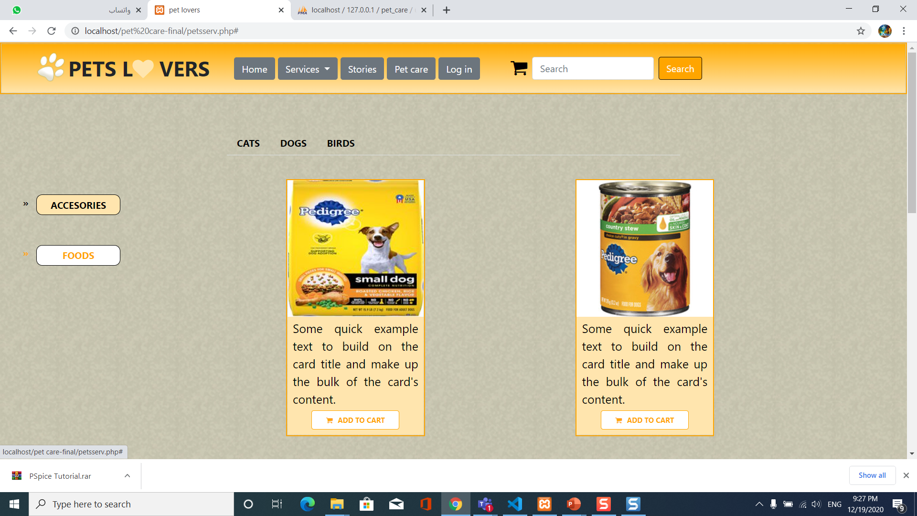
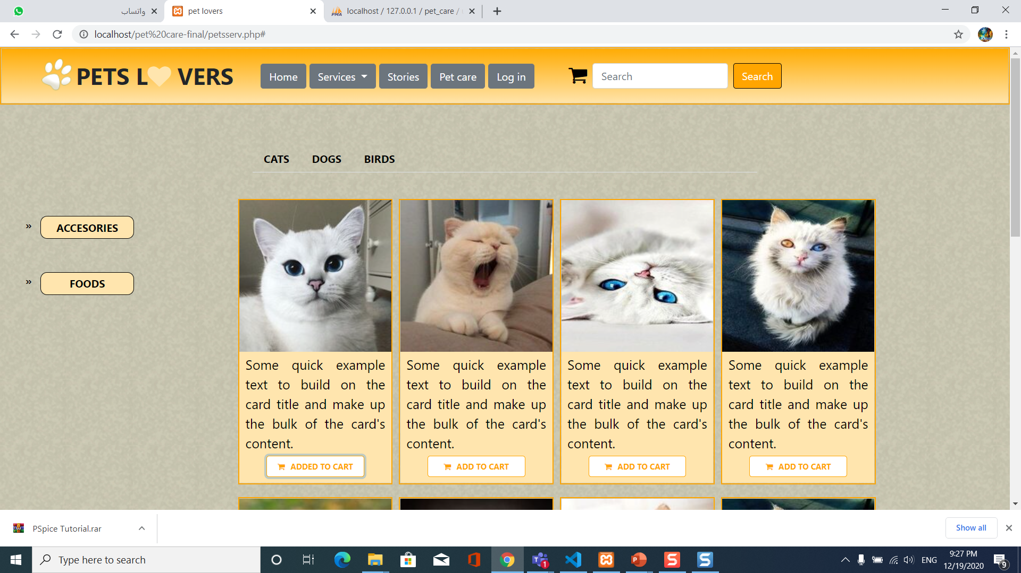

Slide 8
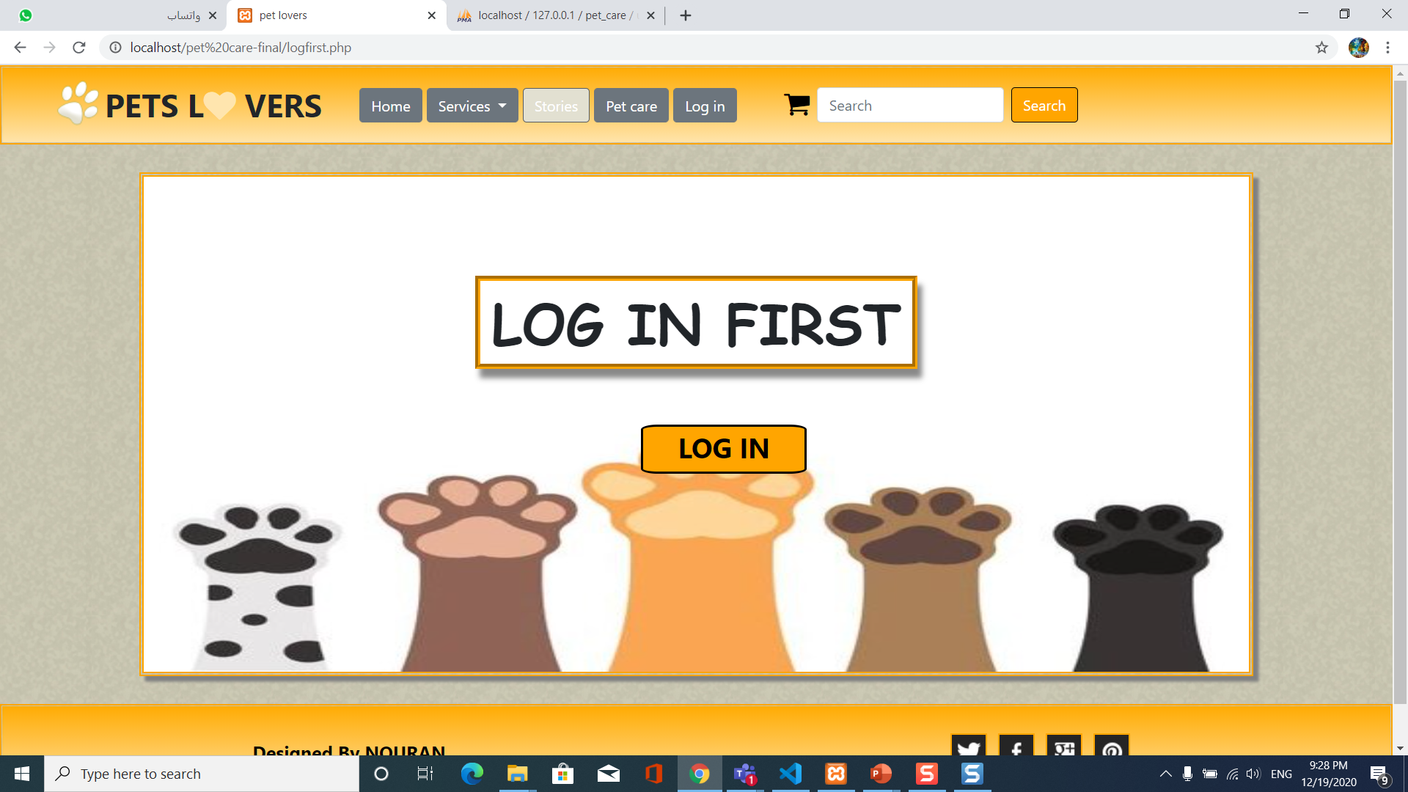
stories

Slide 9
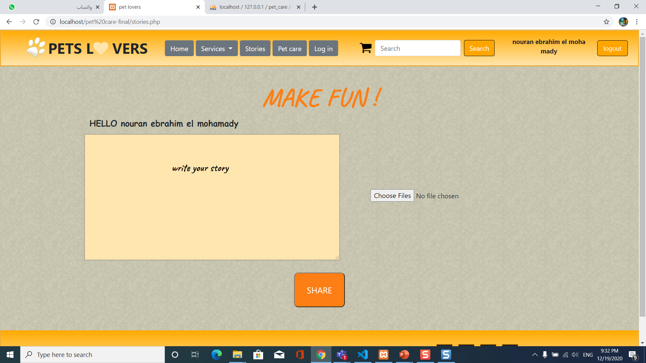

Slide 10
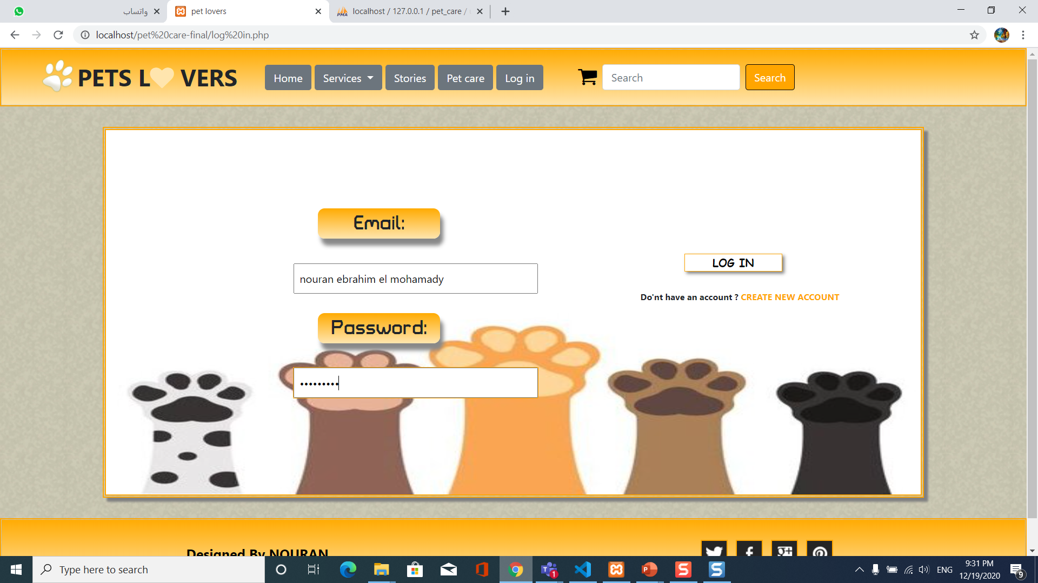
Login
Html
Css
Php
mysql

Slide 11
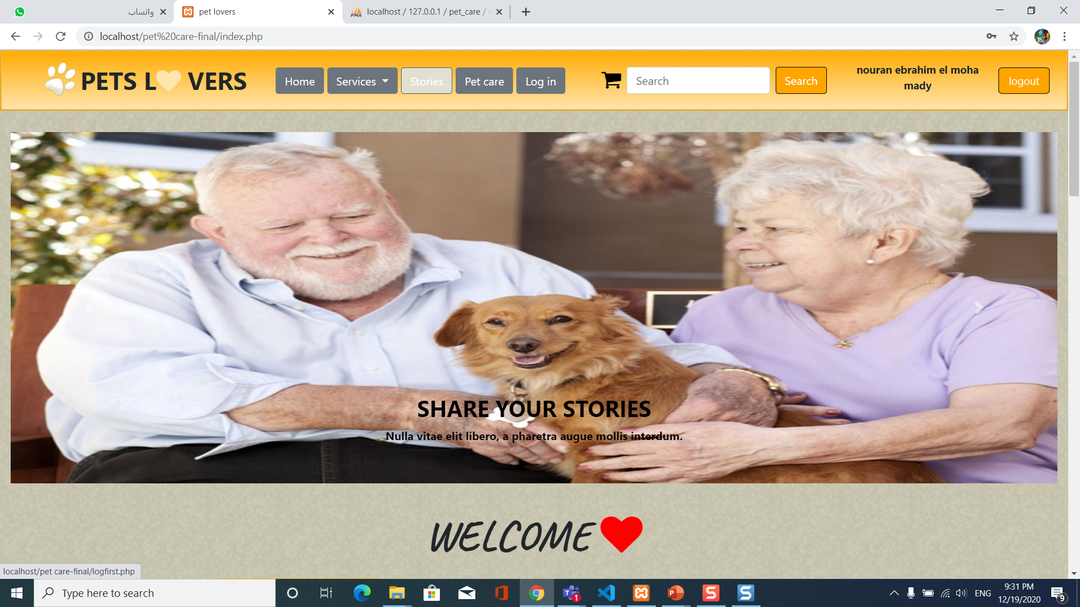

Slide 12
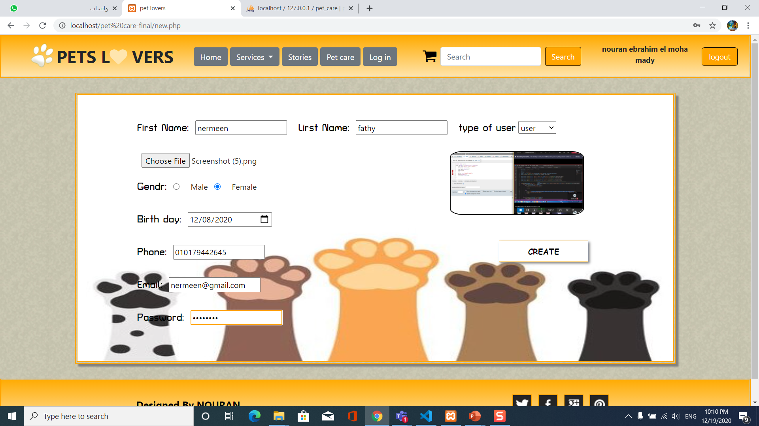
Create new account
Html
Css
Php
jeqry

Slide 13
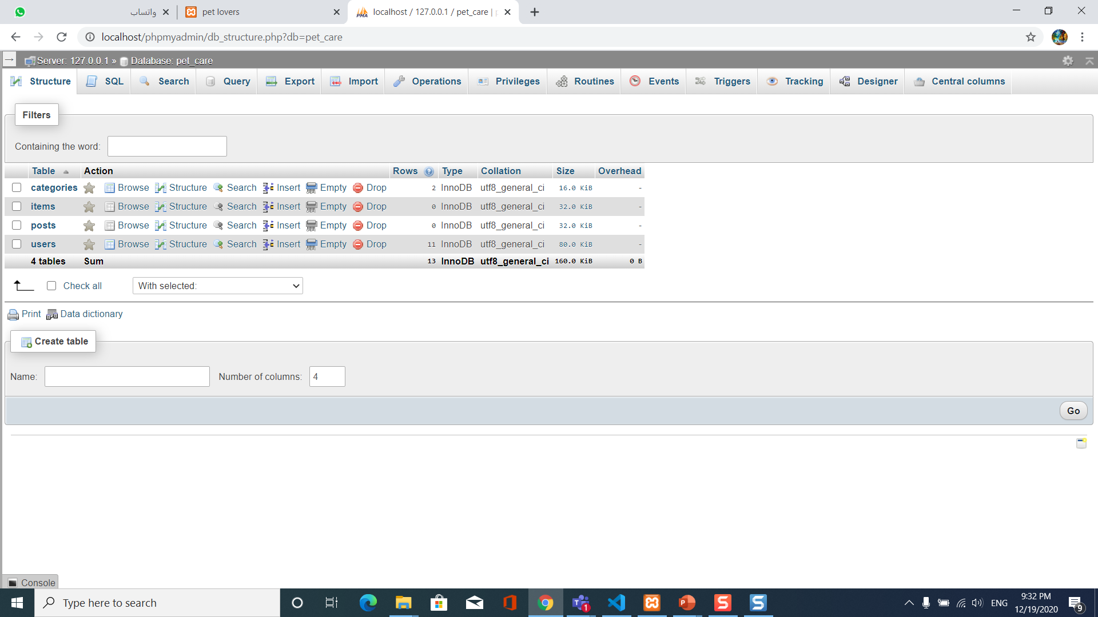
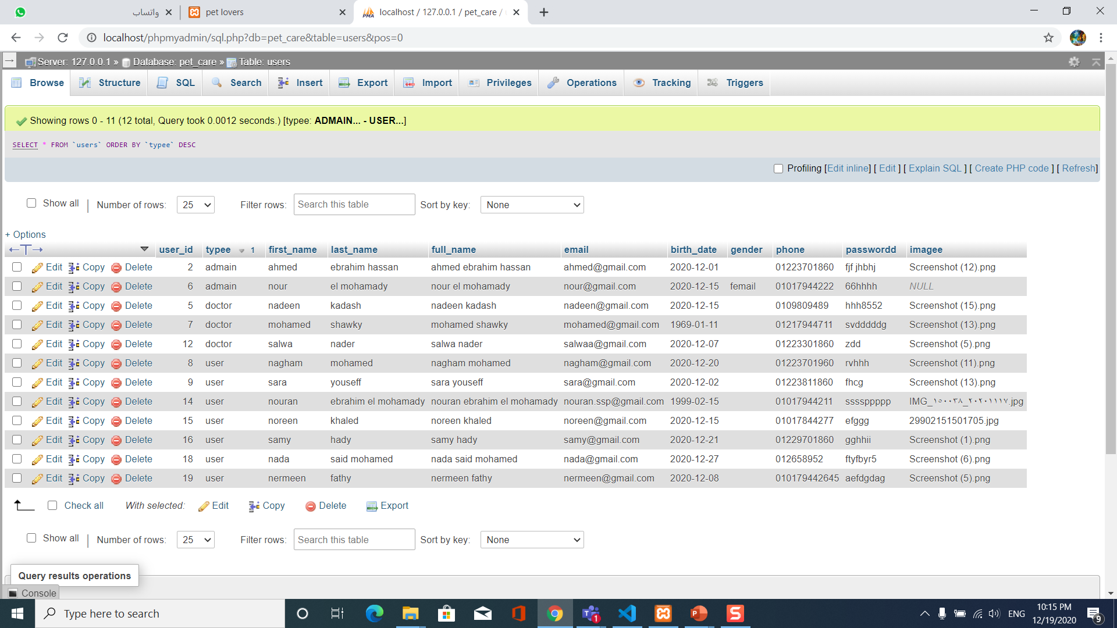
Data base

